Slide 1
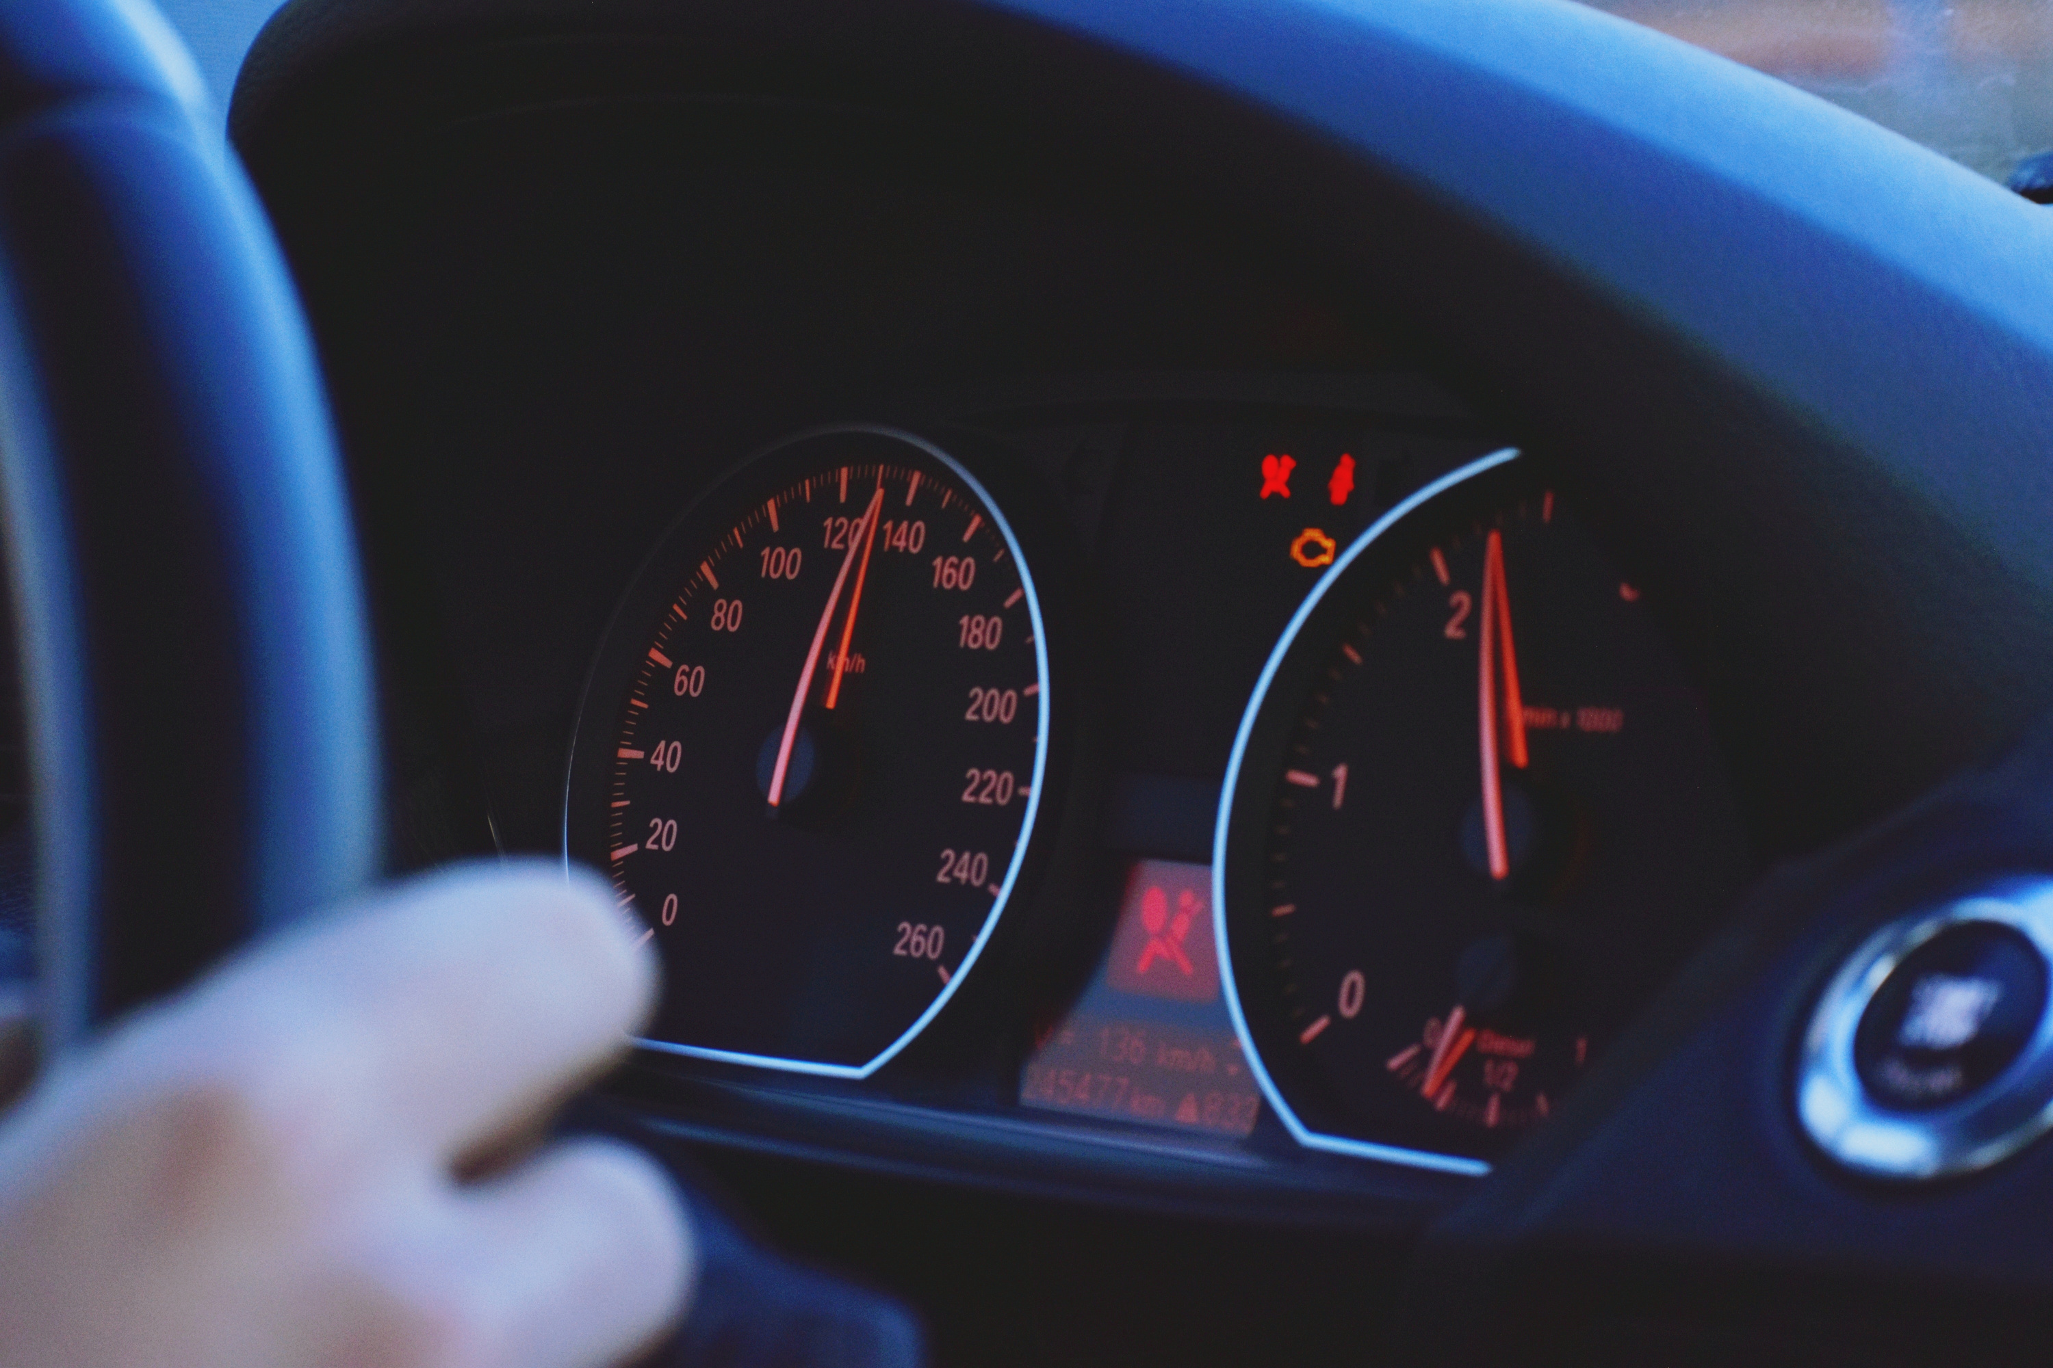
Oilert
Vehicle Maintenance Tracking
2025 Make-IT-Wright Hackathon | Team Twizzy Tech
Team Members:
Wyatt Sellers
Madison Sellers
Subiksha Vaidhyanathan
Makaela Bennett

Slide 2

What is Oilert?
Vehicle Maintenance Tracking App
Log mileage easily
Track oil changes
Receive maintenance reminders
Version control for your car's service history
Helps maintain reliable service records

Slide 3

Problem Statement
Why does this matter?
Increase vehicle life
Reduces life-cycle CO(2) emissions throughout the supply chain [1]
Lessen cost of ownership by up to 50% for every four years extended [2]
Many vehicle owners change oil too early or too late, leading to unnecessary expenses or engine damage [3]
Traditional maintenance tracking is manual and unreliable
No secure, verifiable way to prove a car’s maintenance history when selling it

Slide 4

Solution
Key Features
Add & track multiple vehicles
Log gas fill-ups & calculate mpg
Set reminders for maintenance (oil changes, tire rotations, etc)
View detailed maintenance history

Slide 5




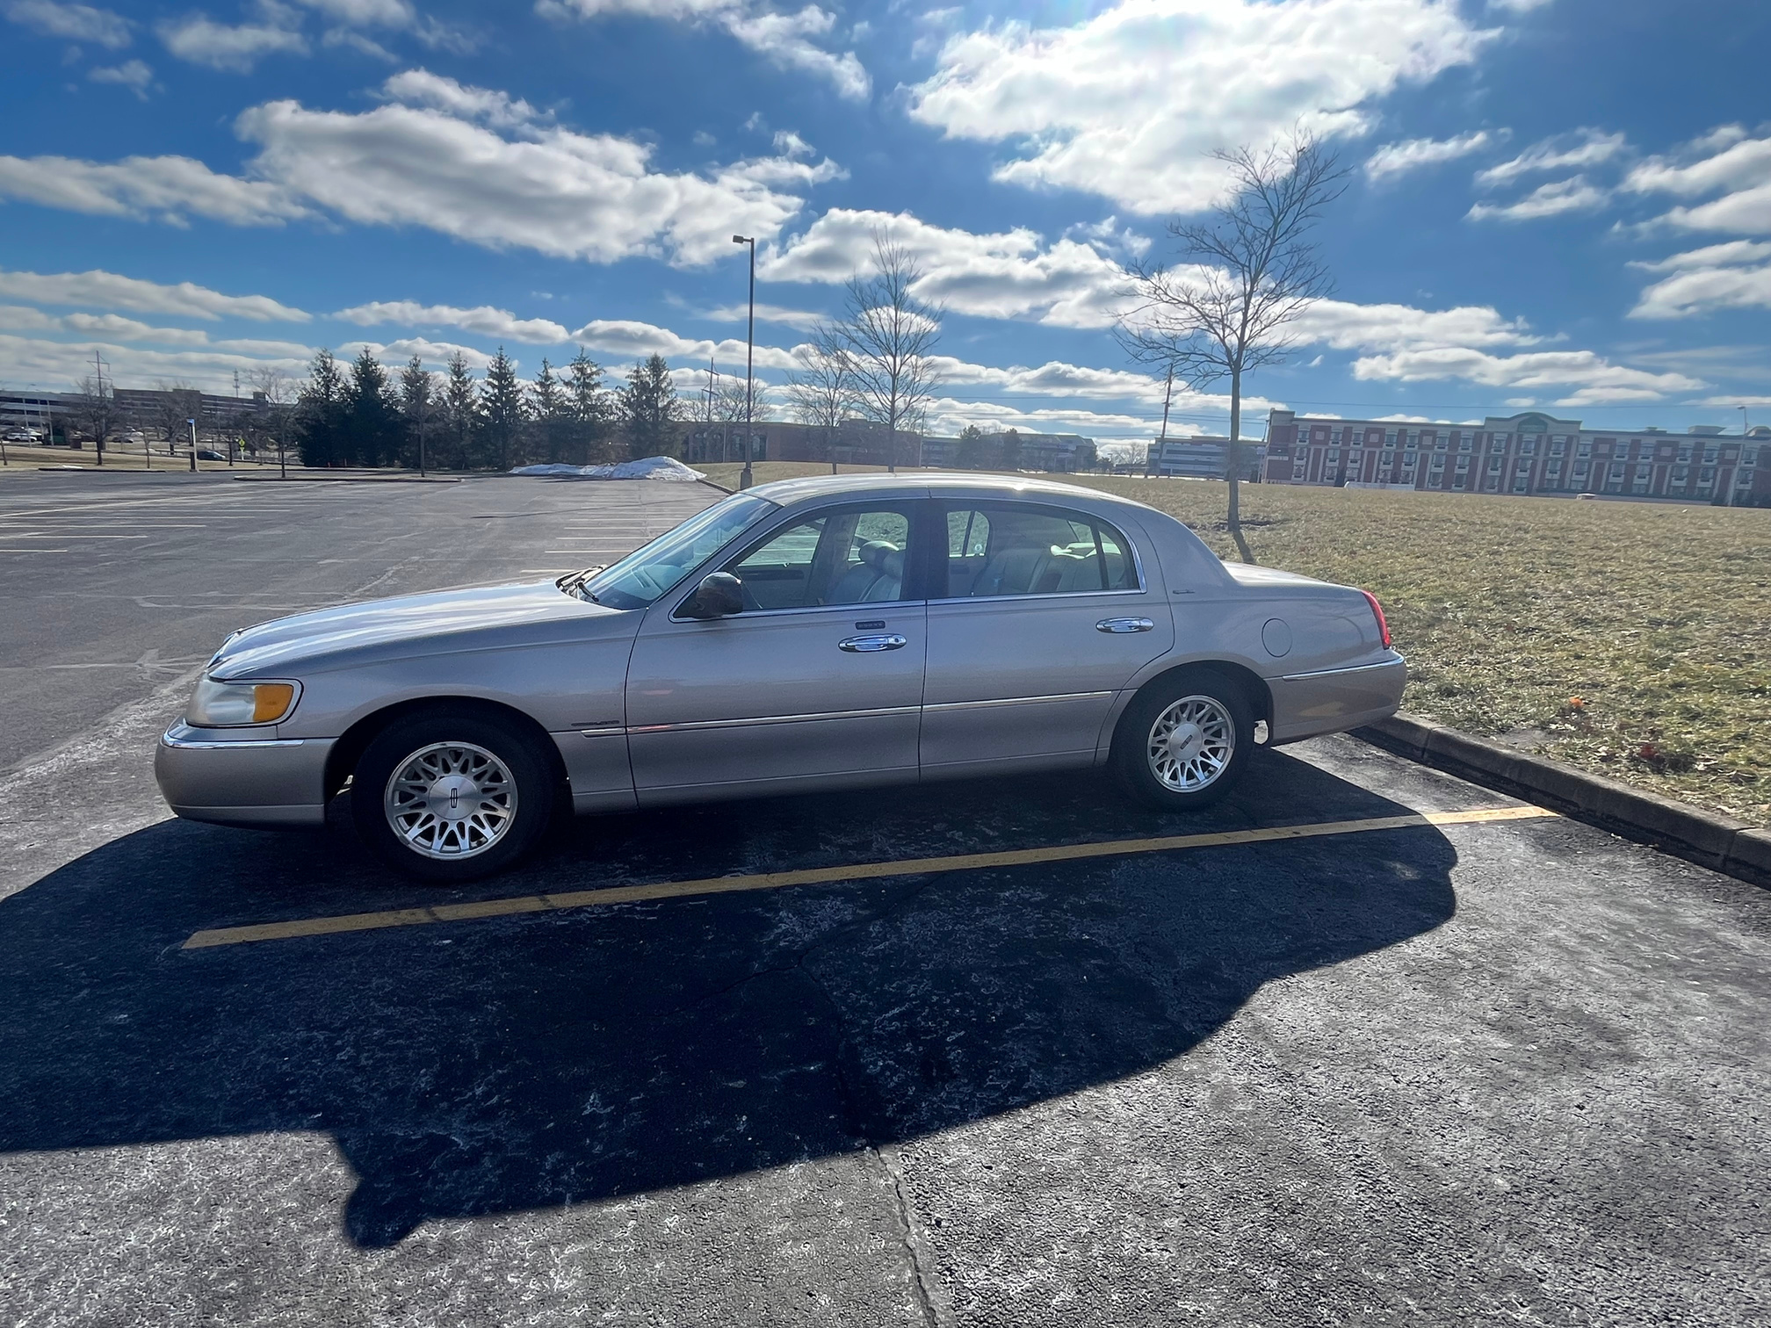

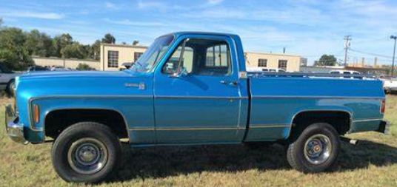



Layout of Oilert -
Loading
2. Main Menu
-Create an account
-Settings: Account
Language
Dark/Light Mode
Oilert
tWizzy
Tech
-Account login
1999 Lincoln Towncar
Login
-Notifications
Miles: 115,263
Username:
-Vehicle Profiles: Dropdown
1978 Chevy Silverado
Password:
Miles: 203,693
Create Account
+ Add Vehicle

Slide 6

Layout of Oilert -
3. Add Vehicle
4. Vehicle Profile
Menu
Oilert
+ Add Photo
Miles:
1999 Lincoln Towncar
Oil Changed:
+
Filled Fuel Tank
+
Changed Oil
Transmission Fluid +
Coolant +
1978 Chevy Silverado
Miles: 203,693
Submit
+ Add Vehicle

Slide 7
Layout of Oilert -
5. Filled Fuel Tank
Menu
1999 Lincoln Towncar
Miles:
Gas (gal):
Date:
m/d/y
Submit

Slide 8
Challenges & Lessons
Challenges We Faced:
Time constraints: building a functional app in 24 hours was difficult
Initial miscommunication on project scope
Debugging and implementing database interactions
Wyatt got sick
What We Learned:
Clear communication is key in team projects
Breaking down tasks makes development more manageable
A well-planned architecture is crucial for future scalability
Wyatt should stay healthy

Slide 9

Future Development
Where We Want to Take Oilert:
Expanded Maintenance Tracking
Monitor oil changes, filter replacements, coolant levels, and more
Based on real usage data and manufacturer guidelines
Predictive Service Alerts
Use historical data to anticipate maintenance needs
Similar to calculating miles per gallon
Cloud Integration
Multi-device access
Automatic data backup
Industry Adoption
Scalable solution for automotive businesses and fleet management

Slide 10

Conclusion and Q&A
Recap:
Oilert solves real-world vehicle maintenance tracking issues
We built a strong foundation for future devlopment
With more time, we aim to turn this into a fully functional, industry-grade app
Any questions?

Slide 11
Sources
https://www.sciencedirect.com/science/article/abs/pii/S0959652618330683
https://deepblue.lib.umich.edu/bitstream/handle/2027.42/192062/CSS04-01.pdf?sequence=1&isAllowed=y
https://www.firestonecompleteautocare.com/blog/oil-change/what-happens-if-you-dont-change-your-oil/

